Slide 1
YOU TUBE VIDEO DOWNLOADER
Team Members
Lucy Adhiambo
Felix Ongera Manyara

Slide 2
TECHNOLOGY USED
Python basics.
Python libraries
Tkinter – is a standard GUI library and it is one of the easiest ways to build a GUI application.
Pytube – used for downloading videos from YouTube.

Slide 3
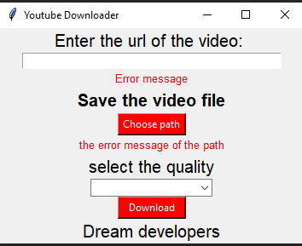
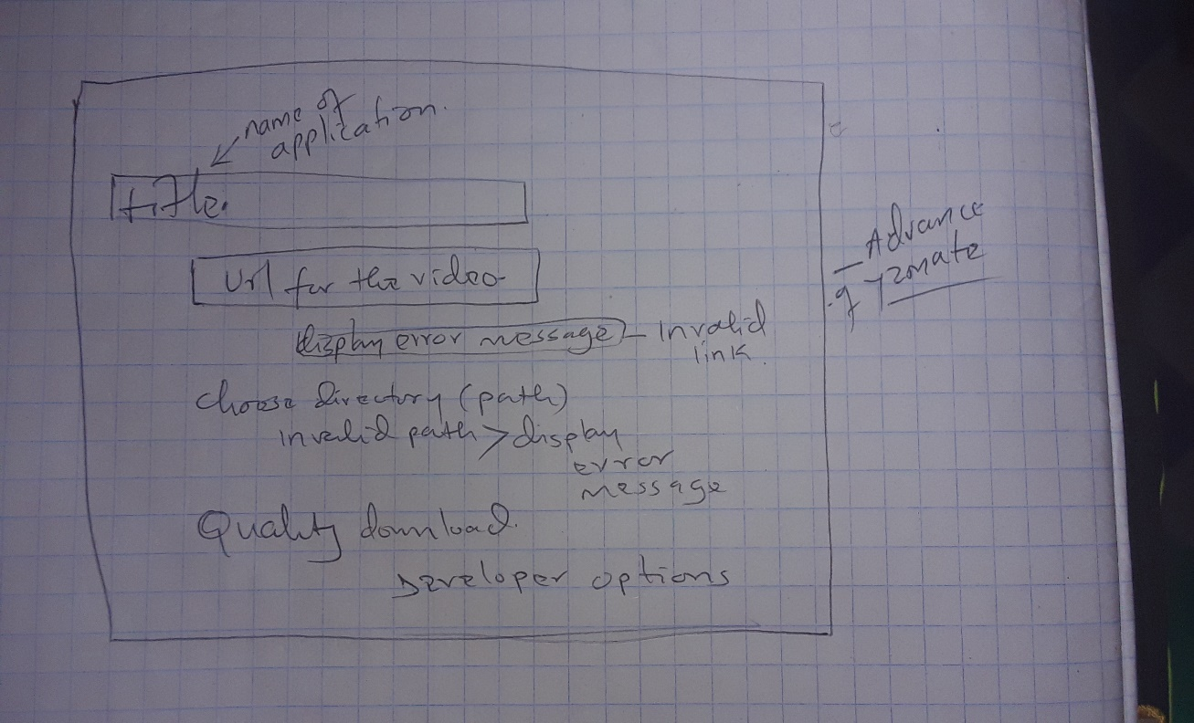
Application design

Slide 4
CHALLENGES
Installation of the python libraries on Vs Code editor and also on wing(PYTHON IDE).
We experienced SSL error while importing and installing tkinter and pytube.

Slide 5
APPRECIATION
We thank the entire chaptr team for the support you showed to us to improve on our various projects.
Thank you.

